Slide 1


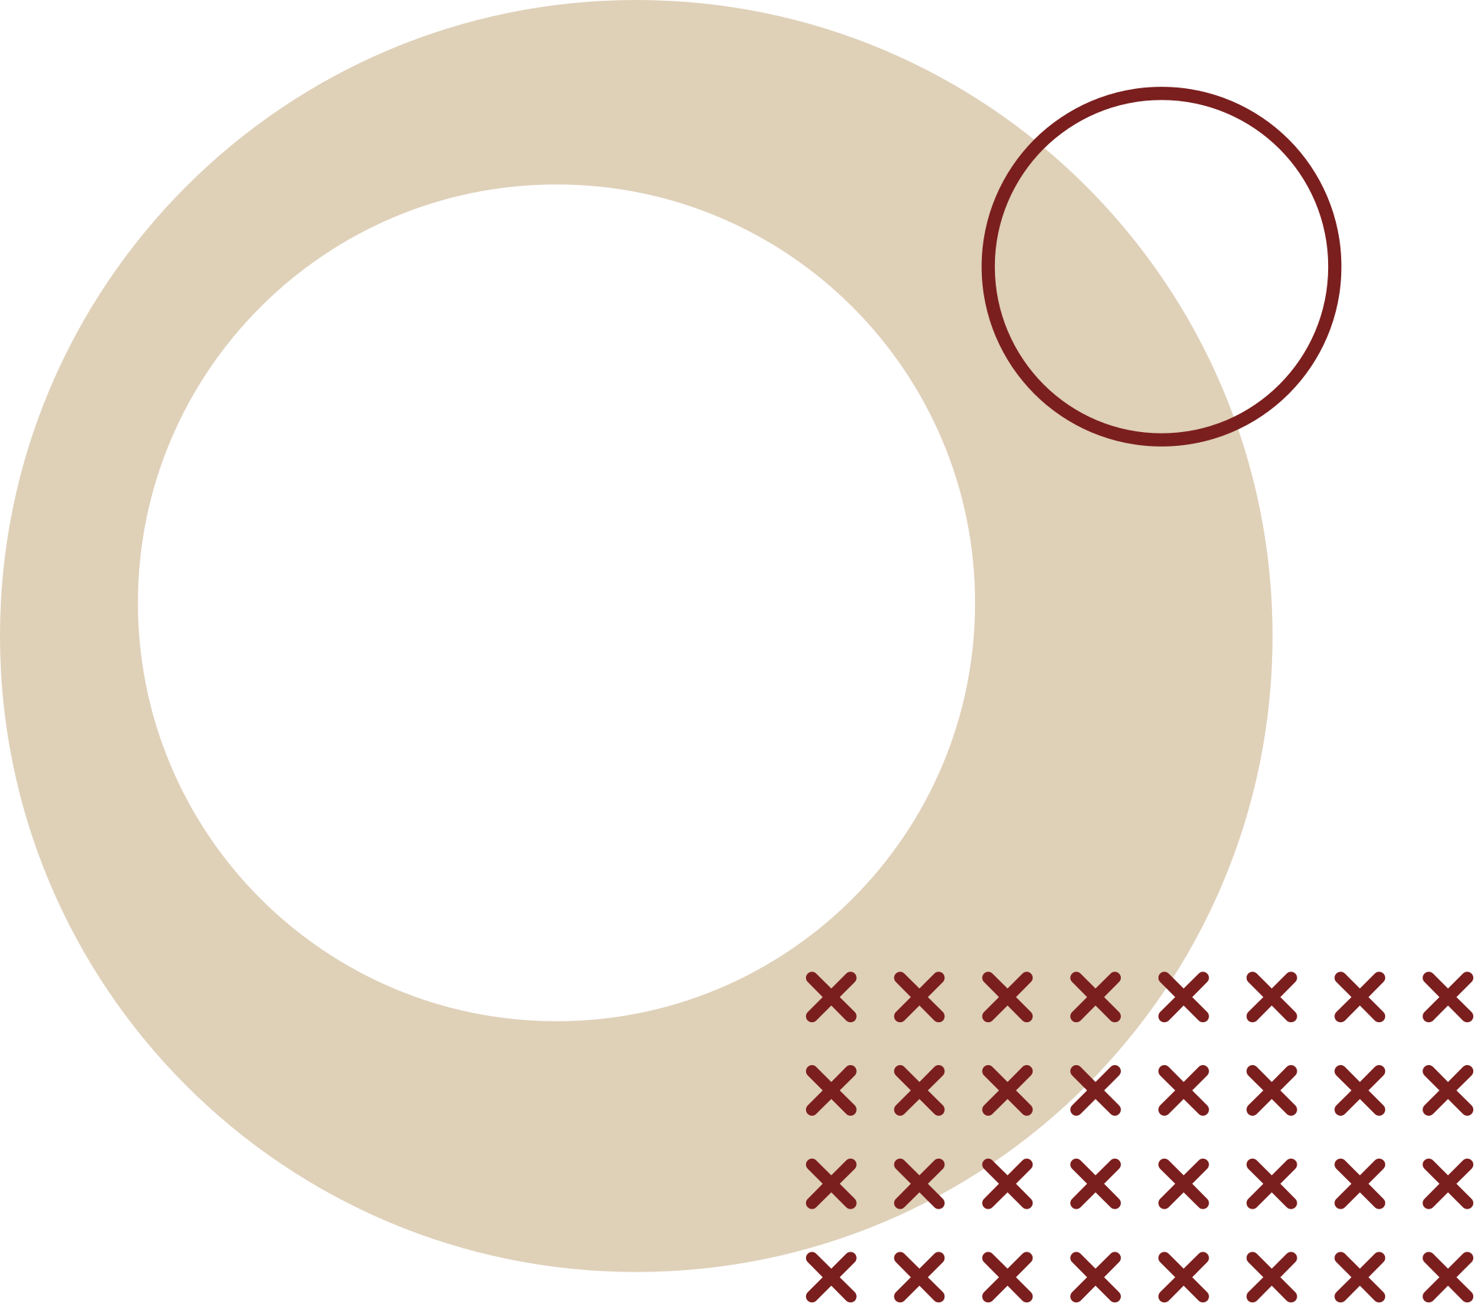
VEER SURENDRA SAI UNIVERSITY OF TECHNOLOGY
DEPARTMENT OF MECHANICAL ENGINEERING
BEAM DEFLECTION ANALYSIS USING PYTHON (MATPLOTLIB & SCIPY)
Submitted by: Saayanpratit Dash
Regd. No: 2402090111 Sec: B

Slide 2
PROBLEM STATEMENT
Manual beam deflection calculations are time-consuming and error-prone.​
Need for an accurate, efficient computational model for beam analysis.
Project applies Python, Matplotlib, and SciPy for structural analysis using Euler–Bernoulli theory.

Slide 3
OBJECTIVE
Model bending moment and curvature for beams.​
Numerically integrate curvature to find slope and deflection.
Apply boundary conditions for simply supported and cantilever beams.
Visualize supports, load position, and deflection with plots.
Provide location and value of maximum deflection for design validation

Slide 4
WORKFLOW
Input beam parameters: length (L), load (P), Young's modulus (E), moment of inertia (I), load position, and beam type (simply supported or cantilever).
Compute bending moment M(x) using piecewise formulas.
Calculate curvature y′′(x)=M(x), EIy′′(x)=EIM(x).
Numerically integrate curvature twice to get slope y′(x)y′(x) and deflection y(x)y(x).

Slide 5
WORKFLOW
Apply boundary conditions: for simply supported, y(0)=0, y(L)=0; for cantilever, y(0)=0, y′(0)=0
Plot deflected shape, supports, load position, and max deflection using Matplotlib.
Output max deflection value and location.

Slide 6
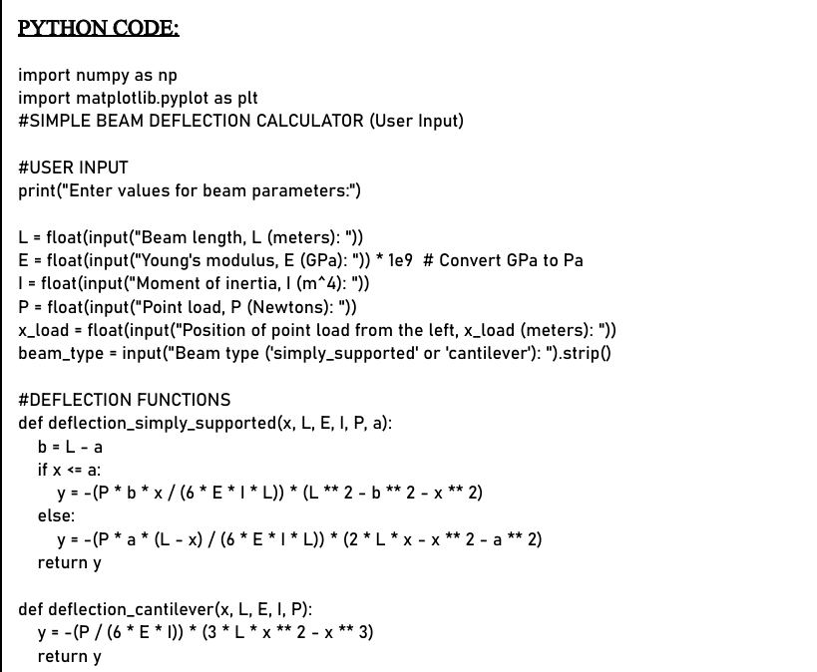
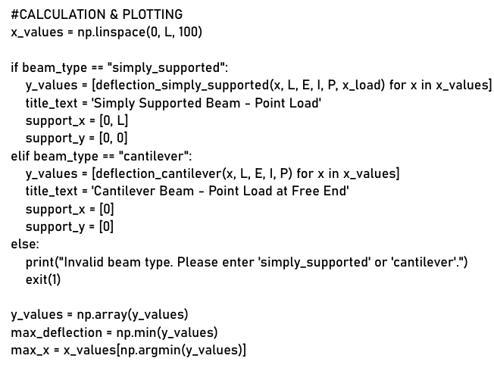
PYTHON CODE
CALCULATION & PLOTTING
USER INPUT & FUNCTION

Slide 7
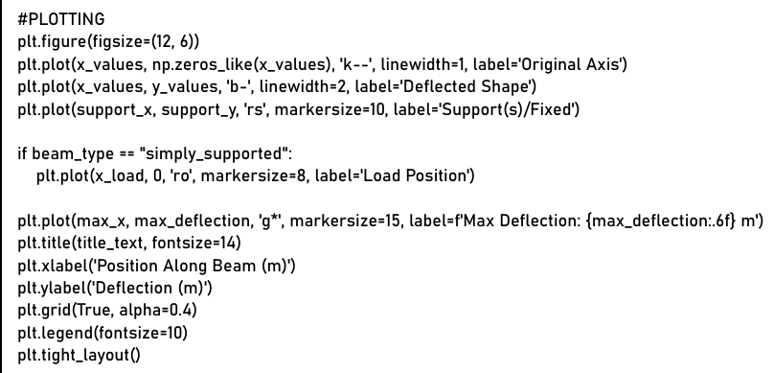
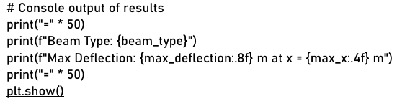
PLOTTING
OUTPUT

Slide 8

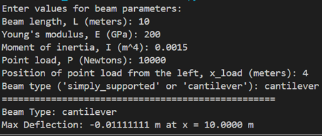
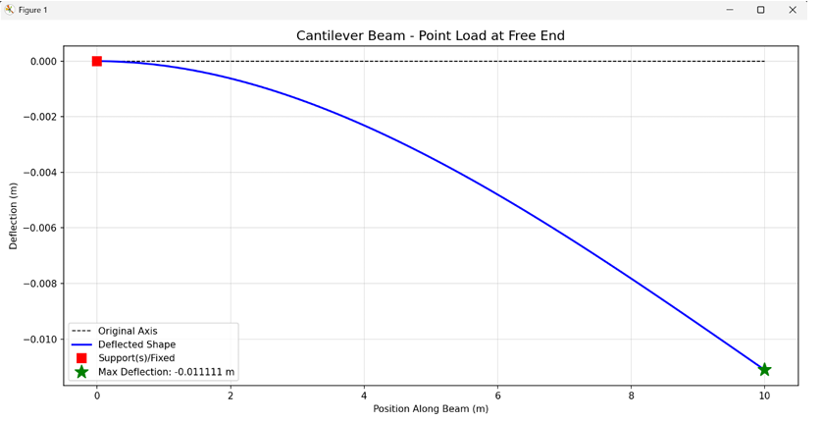
CODE WORKFLOW
User Input a Parameter
Deflection Computed
Values Plotted:Axis, Value, etc
Console Output Provides output

Slide 9
CONCLUSION
Python-based analysis streamlines structural computation.
Accurate prediction and automated plotting aid engineering design.
Foundation for advanced structural applications and simulation work

Slide 10
THANK YOU

